Slide 1

Aptos Developers Portal with AI Assistant
This project integrates document retrieval, a FastAPI-based LLM assistant, and a Next.js frontend to create an enhanced developer experience for Aptos.
Abir Dey and Sriuvaraaj

Slide 2
Project Overview
Document Vector Store Creation
FastAPI Retrieval and LLM Processing
Next.js Frontend
Styled to resemble the Aptos.dev website. An Aptos AI button is integrated into the main navigation, opening a modal for conversation with the LLM.
Scrapes Aptos.dev documentation and converts content into LangChain Document objects. Creates a FAISS vector store using Azure OpenAI embeddings.
Loads the vector store and exposes an API endpoint that performs similarity search, retrieves updated content, constructs a prompt, and uses a HuggingFace-based LLM to generate a response.

Slide 3
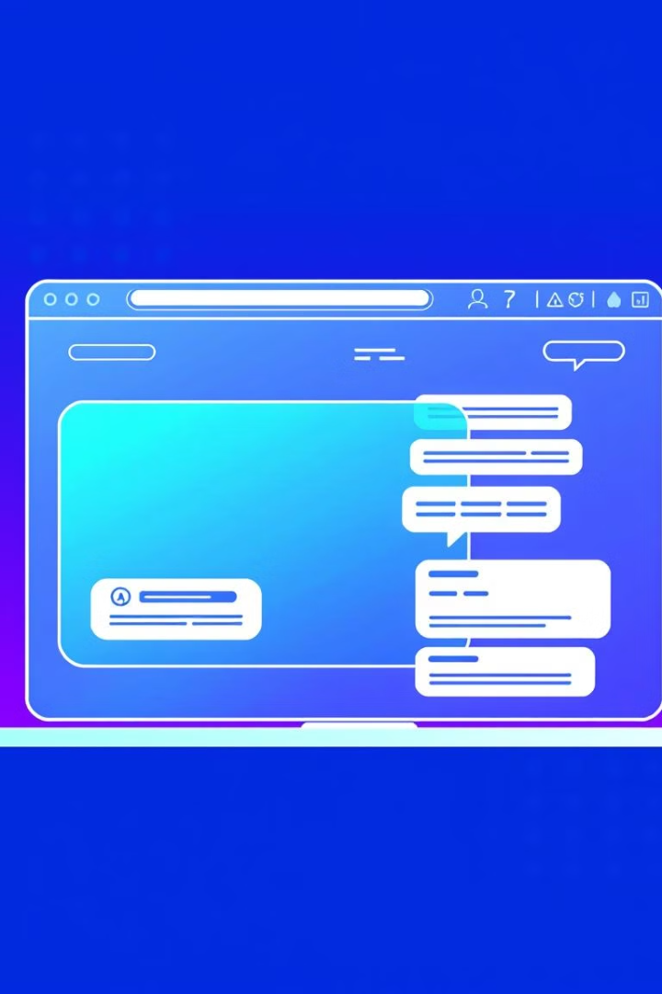


Integration with Aptos.dev
Navigation Bar Update
Aptos AI Modal
Add the Aptos AI button to the main navigation bar.
Create a modal component to handle user queries. This modal should fetch LLM responses via an API handler that calls the FastAPI server.

Slide 4
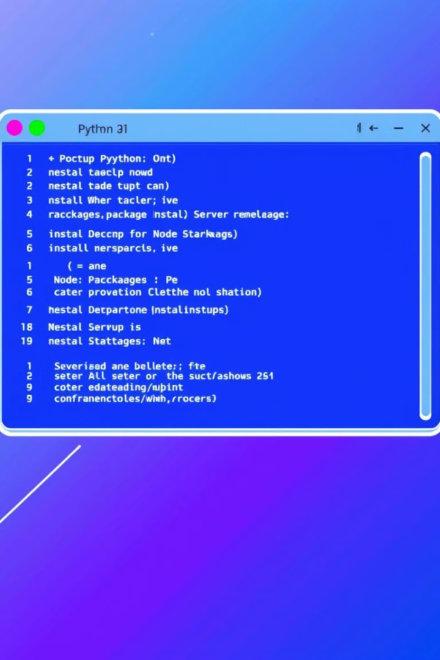
Setup Instructions
Python Environment Setup
Ensure you are using Python 3.9.21. Install required packages using pip install -r python\_requirements.txt. Create the document vector store by running vector\_store.py in Jupyter Notebook. Start the FastAPI server using uvicorn fastapi\_retrieval:app --reload --port 8000.
Node (Next.js) Environment Setup
Install Node dependencies using npm install @langchain/community @langchain/core @huggingface/inference@2 npm install langchain npm install. Start the Next.js application using npm run dev.

Slide 5
How the Application Works
Vector Store Creation
1
The create\_vector\_store.ipynb notebook scrapes the Aptos documentation and converts document content to LangChain Document objects. A FAISS vector store is created using Azure OpenAI embeddings and saved locally.
2
FastAPI Retrieval & LLM Processing
The FastAPI server loads the vector store and exposes a /chat\_endpoint. When a query is submitted, it searches for relevant documents, conducts additional scraping, builds a combined prompt, and sends it to the LLM backend.
Next.js Frontend Functionality
3
The UI, built using TypeScript and TailwindCSS, mirrors the design of Aptos.dev. The API route bridges requests from the frontend to the FastAPI server. The navigation bar includes an Aptos AI button that opens the modal for interactive LLM conversation.
4
Aptos AI Chat Feature
Users can click the Aptos AI button in the navigation. The modal allows users to enter queries and view responses enhanced with Markdown formatting and emojis.

Slide 6
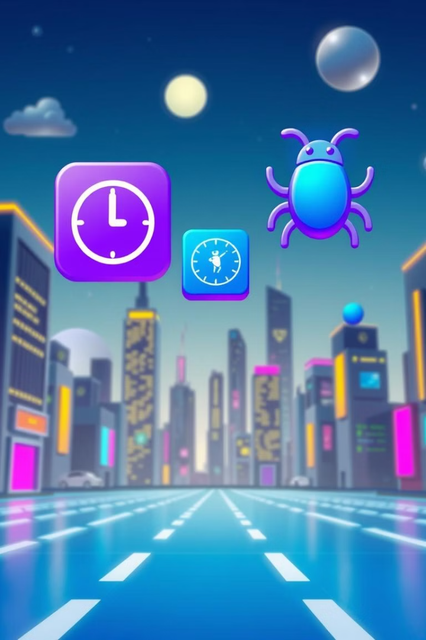
Future Work
Chat History
A persistent chat history module was not implemented. This feature could be considered for implementations with larger context window models or by using paid models.

Slide 7



Conclusion
1
Document Retrieval
2
LLM-Powered Responses
3
Modern Next.js UI

Slide 8
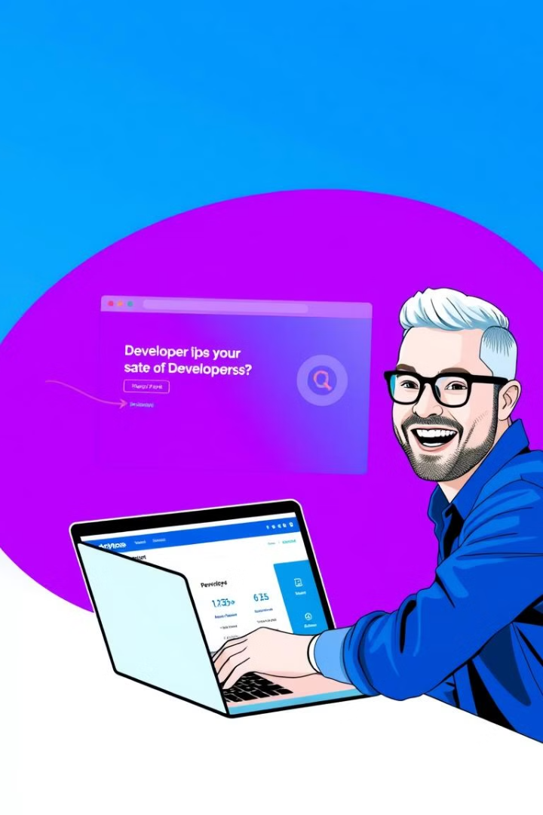
Integration with Aptos.dev
This project presents a full-stack solution that combines document retrieval, LLM-powered responses, and a modern Next.js user interface. With its integration potential into the Aptos.dev platform, it offers an innovative way to assist developers in navigating and understanding Aptos documentation through conversational AI.

